Slide 1
Week 2 – AP Macroeconomics

Slide 2
Unit 5
Unit 5 builds on our study of the models presented in Unit 3 and 4. It goes into more depth about the effects of fiscal policy and monetary policy and relationships between different macro indicators such as inflation and unemployment in the Phillips Curve.

Slide 3
5.1 FP and MP in the Short Run
We have covered Fiscal Policy and Monetary Policy in Unit 3 and 4.
We will revise it briefly and then consider when both FP and MP are used at the same time.

Slide 4
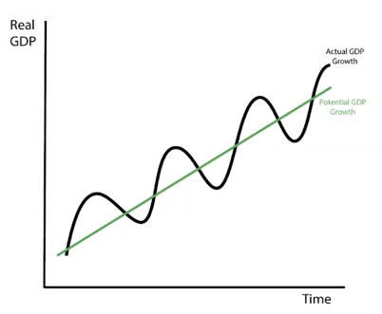
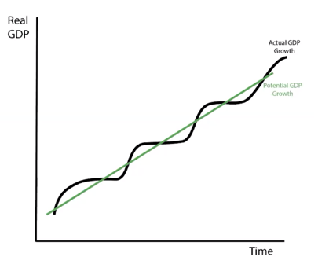
Revision: Stabilization Policies
Both Fiscal Policy and Monetary Policy is conducted with the intention of ‘smoothing’ the business cycle.
This ensures that unemployment or inflation doesn’t fluctuate too rapidly and maintains economic stability.
Remember that automatic stabilizers do this without the government having to implement any new policy.
Stabilization Policies
Fiscal Policy
Monetary Policy
Summary
FP and MP is used to stabilize the economy which means reduce the size of output gaps.

Slide 5
What do we mean when we refer to a ‘stabilization’ policy? What are the two main categories of stabilization policy?
Stabilization Policy - smooth the business cycle, reducing the size of output gaps and changes in unemployment.
Fiscal Policy
Monetary Policy

Slide 6
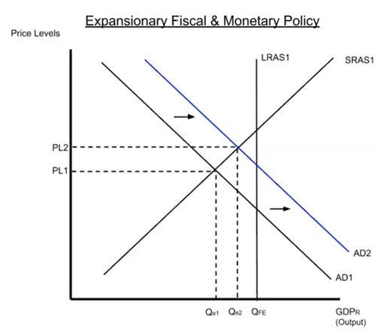
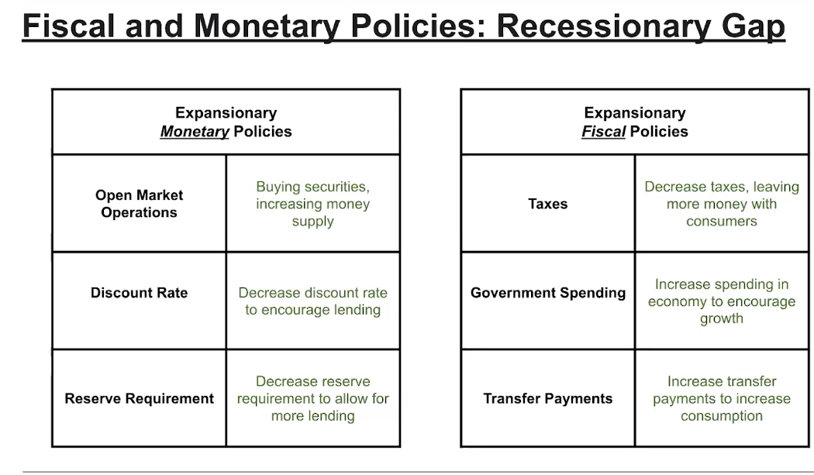
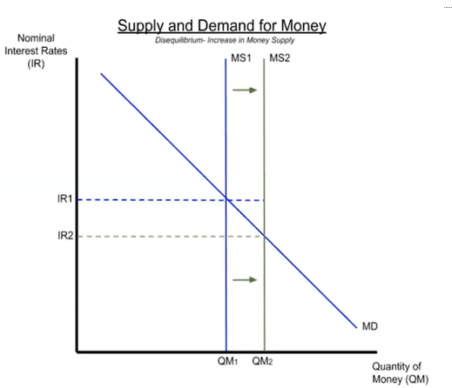
Revision: Expansionary MP and FP
Expansionary FP and MP is used to fight a recession/recessionary gap which has low output and high unemployment.
(Contractionary FP and MP on the other hand is used to fight high inflation associated with positive output gaps.)
Summary
Expansionary FP and MP increases AD, closing a recessionary gap.

Slide 7
Give examples of expansionary MP.
The Fed buys bonds on the open market
The fed decreases the RRR
The Fed decreases the discount rate or federal funds rate.
Ample Reserves Economy: decrease administered interest rates.
Give examples of expansionary FP.
The government can decrease tax.
The government can increase government spending.
The government can increase government transfers.

Slide 8
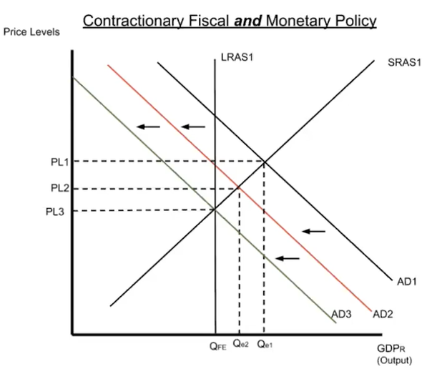
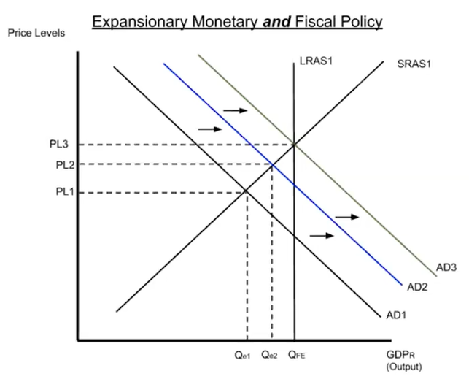
FP and MP Used Together – Same Direction
Summary
FP and MP can work together in the same direction.
Sometimes governments will use both FP and MP at the same time. In these cases the policies will work together to both push AD in the same direction.

Slide 9
Draw the effect of expansionary MP and expansionary FP used together to fight a recessionary gap.
Both would increase AD and help to close the negative output gap.

Slide 10
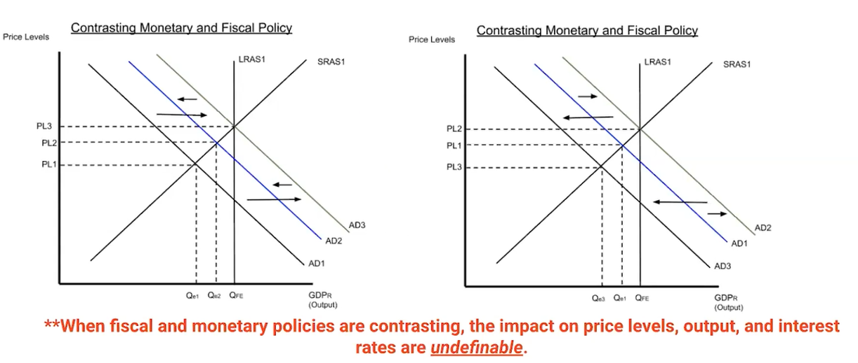
FP and MP Used Together – Opposing Direction
Summary
FP and MP can work in opposite directions, especially if the government and the Federal Reserve aren’t in agreement.
The government implements fiscal policy.
The Federal Reserve implements monetary policy.
Sometimes they may act contrary to each other.

Slide 11
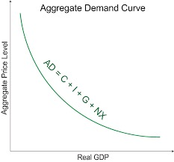
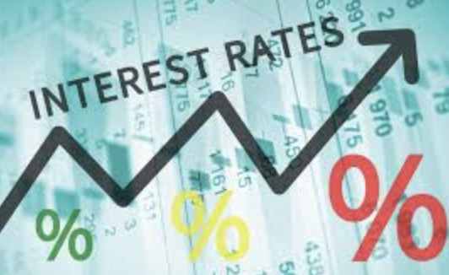
Questions that focus on IR instead of AD
Summary
When there is a FP and MP together question, and they cancel out, the correct answer may be about the interest rate.
Sometimes such questions will be about the interest rate instead of AD, when they ‘cancel each other out’

Slide 12
If the government increases spending while the country’s central bank sells bonds on the open market, which of the following will definitely occur?
The aggregate demand curve will shift to the right.
The aggregate demand curve will shift to the left.
The short-run aggregate supply curve will shift to the right.
Interest rates will fall.
Interest rates will rise.
Answer: E
Why?
Increased Gov spending -> increased Gov Borrowing -> Increase DLF -> Increase RIR (OR Increased Gov spending -> Increase MD -> Increase NIR)
Sell bonds –contractionary MP -> Increase IR
Therefore Increase IR
Increased Gov spending = expansionary FP -> Increase AD
Sell bonds –contractionary MP -> Decrease AD
Therefore effect on AD unclear

Slide 13
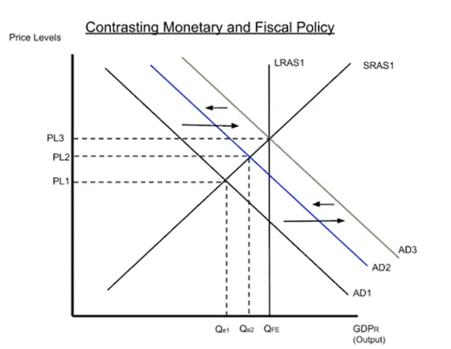
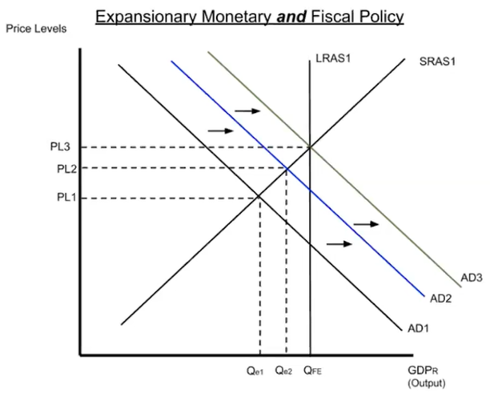
FP and MP in the Short Run Summary
FP and MP is designed to stabilize the economy, reducing the size of business cycles.
FP can work together and move in the same direction (eg. Both increase AD) OR work in opposing directions (eg. FP increases and MP decreases AD).

Slide 14
5.2 The Phillips Curve

Slide 15
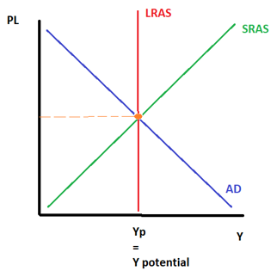
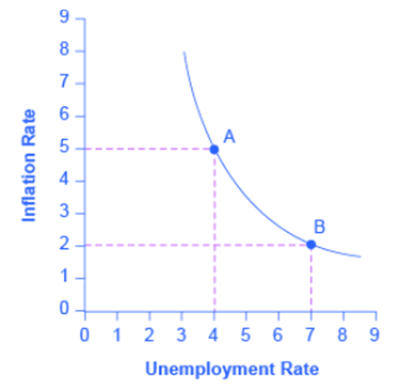
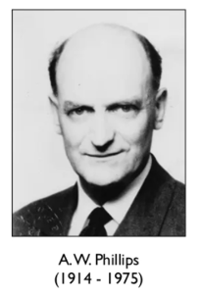
The Phillips Curve - Introduction
The AD/AS Graph
The AD/AS graph represents the big three economic indicators
Output (Real GDP, Real Income, Y)
Unemployment
Price Level
Summary
The Phillips Curve Shows the r’ship between price level and unemployment
The Phillips Curve
The Phillips Curve, named after economist A.W. Phillips shows the relationship that exists between Unemployment and Price Level. We can think of this as a complement to the AD/AS graph.

Slide 16

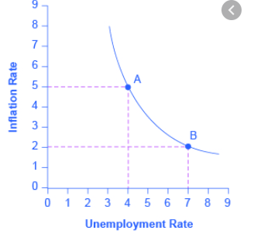
The Phillips Curve and Output Gaps
Summary
-ve output gap – ↓ Infl ↑ UR
Long Run Equilibrium – Natural Infl, NRU
+ve output gap – ↑Infl↓UR
We can see that movements of the AD curve, which cause positive or negative output gaps will move us to different points along the same Short Run Phillips Curve.
PC
Natural Rate of Inflation = NRU
Full Employment / Long Run Equilibrium

Slide 17
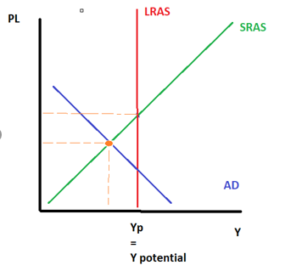
The Phillips Curve and Output Gaps
Summary
-ve output gap – ↓ Infl ↑ UR
Long Run Equilibrium – Natural Infl, NRU
+ve output gap – ↑Infl↓UR
We can see that movements of the AD curve, which cause positive or negative output gaps will move us to different points along the same Short Run Phillips Curve.
PC
Low inflation = higher unemployment
Natural Rate of Inflation = NRU
-ve Output Gap
Full Employment / Long Run Equilibrium

Slide 18
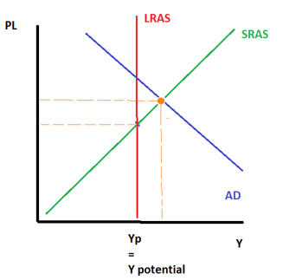
The Phillips Curve and Output Gaps
Summary
-ve output gap – ↓ Infl ↑ UR
Long Run Equilibrium – Natural Infl, NRU
+ve output gap – ↑Infl↓UR
We can see that movements of the AD curve, which cause positive or negative output gaps will move us to different points along the same Short Run Phillips Curve.
There is a negative relationship between Unemployment and Inflation!
PC
Low inflation = higher unemployment
High inflation = lower unemployment
Natural Rate of Inflation = NRU
-ve Output Gap
Full Employment / Long Run Equilibrium
+ve Output Gap

Slide 19

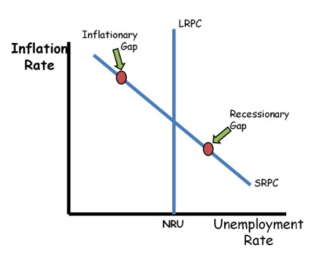

Name Change – The Short Run Phillips Curve (SRPC)
The Phillips Curve that has a negative relationship between inflation and unemployment is called the Short Run Phillips Curve.
This is abbreviated to SRPC.
With the SRPC we are dealing with the short run in the economy, where wages and resource costs are sticky.
We will later cover the Long Run Phillips Curve.
Summary
We can call this –ve slope Phillips Curve the Short Run Phillips Curve SRPC

Slide 20
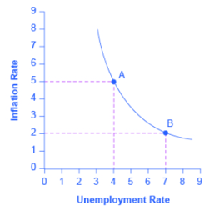
What is the relationship between inflation and unemployment according to the Phillips Curve?
There is a negative relationship between inflation and unemployment.
Negative Output Gap = Less jobs/higher unemployment and lower price level
Positive Output Gap = more jobs/lower unemployment and higher price level
Draw a Phillips Curve.
PC

Slide 21
The Natural Rate of Unemployment
Long Run Equilibrum/Y_{P}/Y_{f}
When the economy is in long run equilibrium/full employment output/potential output, the economy will have these three things occurring at the same time.
Full Employment Output/Y_{P}/Y_{f}
Natural Rate of Unemployment
The Natural Rate of Inflation (bonus)
The NRU / NAIRU
Recall that when the economy is at full employment, we have the Natural Rate of Unemployment, NRU. (Zero Cyclical Unemployment).
This is sometimes more confusingly called the Non Accelerating Inflation Rate of Unemployment (NAIRU). This is the same idea as the NRU, but simply states that at equilibrium, inflation will be at a non-accelerating level.
Natural Rate of Inflation
/ Expected Rate of Inflation
PC
NRU
Expected Rate of Inflation /The Natural Rate of Inflation
Some economists speculate that when the economy is at full employment and has the NRU, we have a corresponding level of inflation. This can be considered the ‘good, happy, sustainable’ level of inflation. We call this the Natural Rate of Inflation.
Expected Inflation and NRU
Full Employment / Long Run Equilibrium
Summary
At Y_{f}/Y_{P} we have the NRU and the Natural Rate of Inflation together.

Slide 22
The Natural Rate of Unemployment
Long Run Equilibrum/Y_{P}/Y_{f}
When the economy is in long run equilibrium/full employment output/potential output, the economy will have these three things occurring at the same time.
Full Employment Output/Y_{P}/Y_{f}
Natural Rate of Unemployment
The Natural Rate of Inflation (bonus)
The NRU / NAIRU
Recall that when the economy is at full employment, we have the Natural Rate of Unemployment, NRU. (Zero Cyclical Unemployment).
This is sometimes more confusingly called the Non Accelerating Inflation Rate of Unemployment (NAIRU). This is the same idea as the NRU, but simply states that at equilibrium, inflation will be at a non-accelerating level.
Natural Rate of Inflation
/ Expected Rate of Inflation
PC
NRU
Expected Rate of Inflation /The Natural Rate of Inflation
Some economists speculate that when the economy is at full employment and has the NRU, we have a corresponding level of inflation. This can be considered the ‘good, happy, sustainable’ level of inflation. We call this the Natural Rate of Inflation.
Expected Inflation and NRU
Full Employment / Long Run Equilibrium
Summary
At Y_{f}/Y_{P} we have the NRU and the Natural Rate of Inflation together.

Slide 23
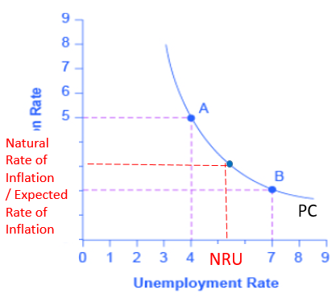
At the long run equilibrium, what can be said about the unemployment rate.
At Y_{P} we have the NRU.
What level of unemployment and inflation would this correspond to on the Phillips Curve.
The NRU and the expected rate of inflation.

Slide 24
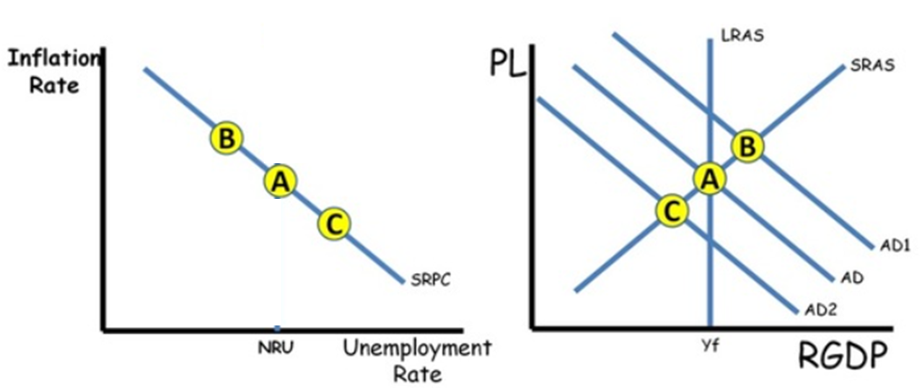
Movement Along the Short Run Phillips Curve
We can see that movements of the AD curve, cause movements along the SRPC.
So we can also observe the effect of FP and MP on the SRPC
Expansionary FP/MP – movement to the left along the SRPC
Contractionary FP/MP – movement to the right along the SRPC
Note: When the AD/AS equilibrium moves right, there is a movement to the left along the SRPC.
Summary
AD shifts lead to movements ALONG the SRPC

Slide 25
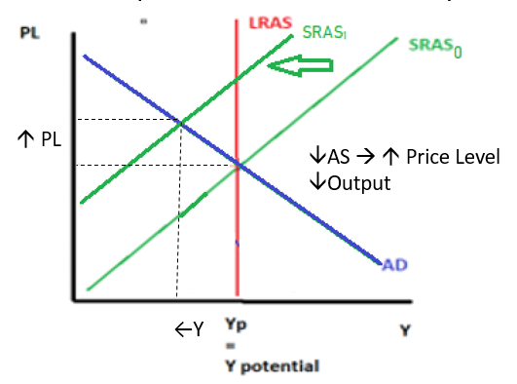
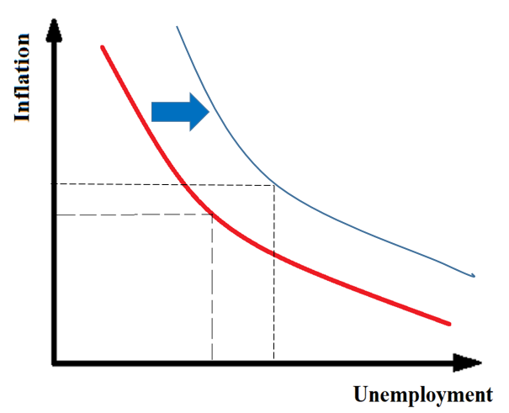
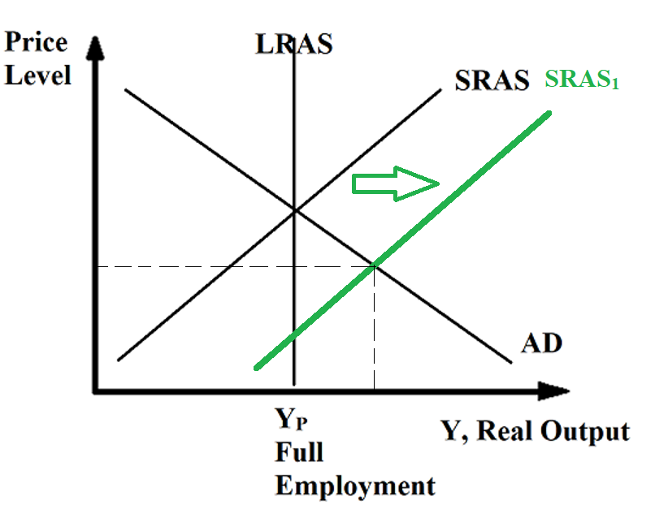
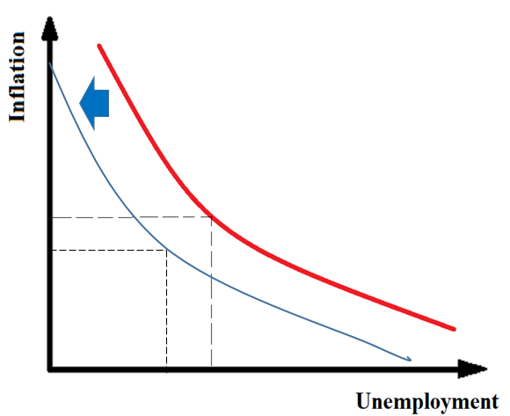
Movement of the SRPC
The movements of the SRPC are connected to the SRAS curve.
The SRPC moves as a ‘mirror image’ to the SRPC.
↓ SRAS→ ↑ Price Level, (↓Output →↓Jobs→↑Unemployment)
↑SRAS→↓Price Level, (↑Output →↑Jobs→↓Unemployment)

Slide 26
↓ SRAS→ ↑ Price Level, (↓Output →↓Jobs→↑Unemployment)
SRPC₁
SRPC₀

Slide 27
↑SRAS→↓Price Level, (↑Output →↑Jobs→↓Unemployment)
SRPC₀
SRPC₁

Slide 28
If the SRAS shifts to the right due to an increase in productivity, what happens to the Phillips Curve?
The SRPC will shift to the left. It moves in the opposite direction of the SRAS.

Slide 29
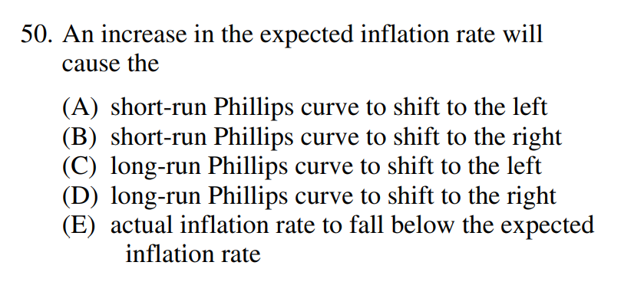
Past AP Question
Correct Answer: B
When inflation expecations are higher, this will lead to people demanding an increase in wages as well as the price of resources that they sell, resulting in a decrease (shift left) of the SRAS.
The left shift of the SRAS causes a right shift of the SRPC

Slide 30
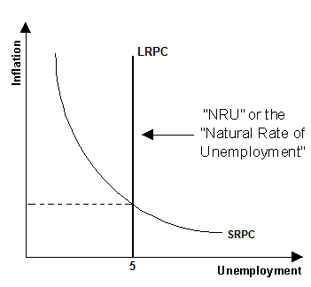
Short Run vs Long Run Phillips Curve
Summary
Short Run Phillips Curve (SRPC) – negative relationship between unemployment and inflation
Long Run Phillips Curve (LRPC) – NO relationship between unemployment and inflation
The Phillips curve shows that there is a tradeoff between inflation and the UR.
However, in the long run there is no trade off between inflation and unemployment.
This is because in the long run, price level has no effect on output because of flexible wages in the long run. Because there is no change in output, there is no change in unemployment.
Regardless of the inflation level, the unemployment will be the same.
Therefore, we distinguish between:
Short Run Phillips Curve (SRPC) – tradeoff between inflation and UR
Long Run Phillips Curve (LRPC) – NO TRADEOFF between inflation and the UR
Note that the LRPC is connected to the NRU.

Slide 31
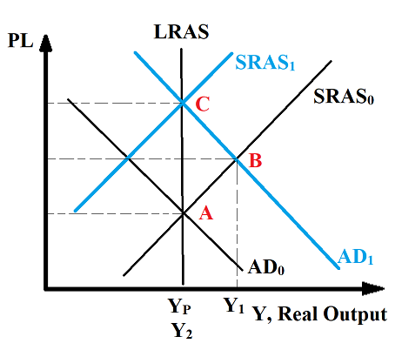
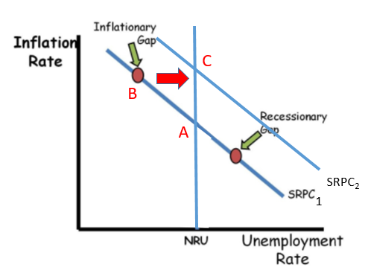
Macroeconomic Self Adjustment – LRPC and SRPC
We now know how to draw the AD/AS self adjustment process. We can now represent this on the Phillips Curve.
We now know the movements that occur to the Phillips Curves
AD shifts move along the SRPC
SRAS shifts move the SRPC
Remember that at Y_{F} you will see a return to Y_{P} which will have the NRU.
Summary
The self adjustment process can be represented on the AD/AS graph AND Phillips Curve graph.
Inflationary Gap Self Adjustment with Phillips Curve
LRPC

Slide 32
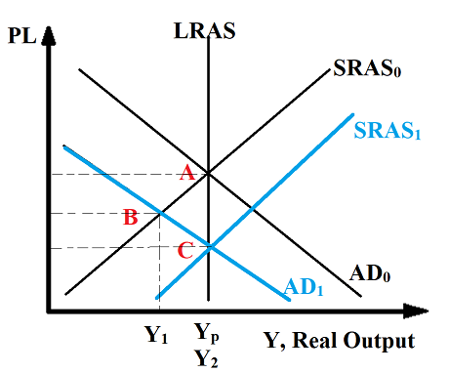
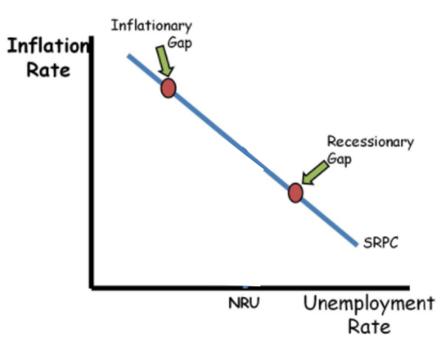
Recessionary Gap Self Adjustment with Phillips Curve
LRPC
A
B
C
SRPC₂

Slide 33
Draw the long run self adjustment of an economy from a positive output gap using an AD/AS graph and a Phillips Curve.
Inflationary Gap Self Adjustment with Phillips Curve

Slide 34
What can be said of the relationship between Inflation and Unemployment with the LRPC and SRPC?
SRPC – inverse relationship between inflation and unemployment
LRPC – no relationship

Slide 35
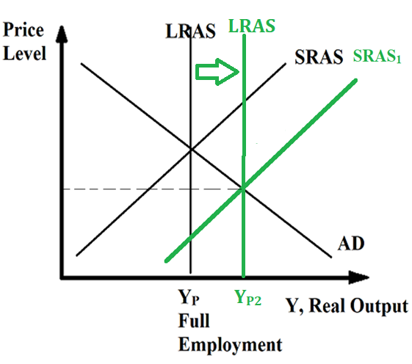
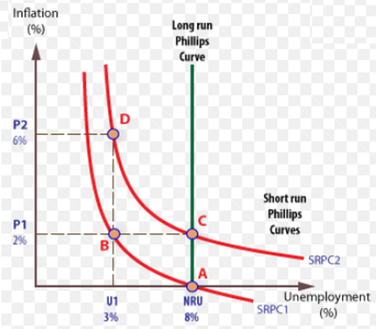
Shift of LRAS – Shift of SRPC
Shift of LRAS will have a similar effect to shift of SRAS, however, because we are moving to another Yp, we will not move from the NRU.
Therefore, we will move a point up or down the LRPC.
Summary
A shift of the LRAS will shift the SRPC however, we will remain at the NRU, because we are once again at Yp.
C
A

Slide 36
Movement of the LRPC
Recall: The NRU = structural unemployment + frictional unemployment
Typically, the LRPC doesn’t shift, because it is determined by the Natural Rate of Unemployment, NRU, which changes when there is a change to structural unemployment or frictional unemployment.
Summary
A change of the NRU either through a change to structural or frictional unemployment will shift the LRPC.
However, in most questions it rarely shifts.

Slide 37
Change to what thing within the economy would shift the LRPC?
The Natural Rate of Unemployment
Structural Unemployment
Frictional Unemployment

Slide 38
Phillips Curve Changes Summary

Slide 39
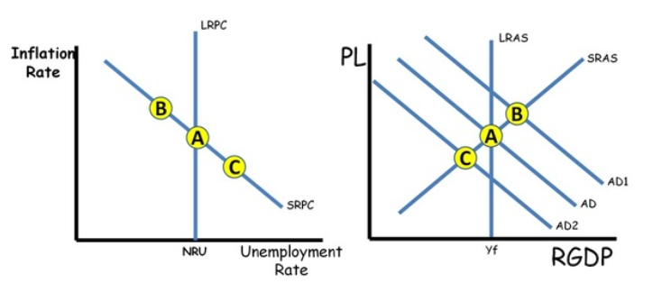
Movement along the SRPC – AD shifts

Slide 40
Shifts of the Phillips Curve
AD/AS Change | Effect on Phillips Curve
AD ↑AD ↓AD | Movement along SRPC Movement to the left along the SRPC Movement to the right along the SRPC
SRAS ↑SRAS ↓SRAS | Shift of SRPC SRPC shifts to the left. SRPC shifts to the right.
Change in the NRU ↑NRU ↓NRU | Shift of LRPC LRPC shifts to the right. LRPC shifts to the left.

Slide 41
Module 34

Slide 42
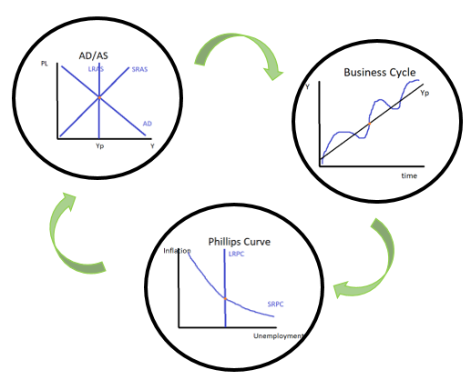
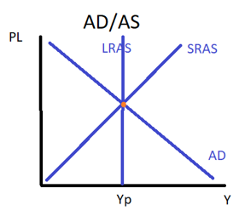
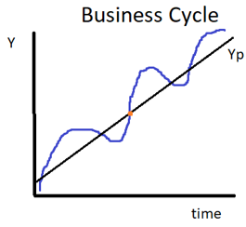
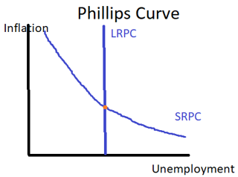
Connecting the Macro Curves
Remember that an economy can be in three situations: Positive output gap, Long run/potential output, Negative output gap
We have another graph that we can use to help represent these states; the Phillips Curve.
These situations can all be shown on the following graphs.
Business Cycle
PPC
AD/AS
Phillips Curve

Slide 43
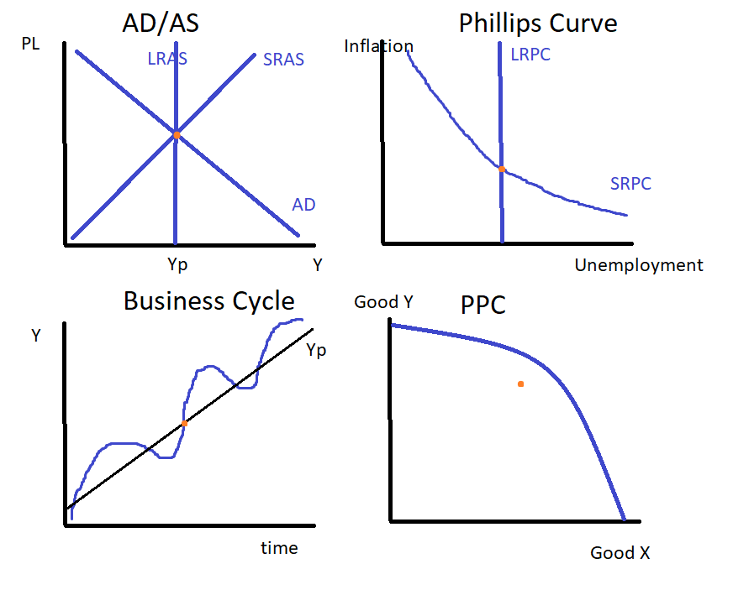
Potential Output/Long Run Equilibrium

Slide 44
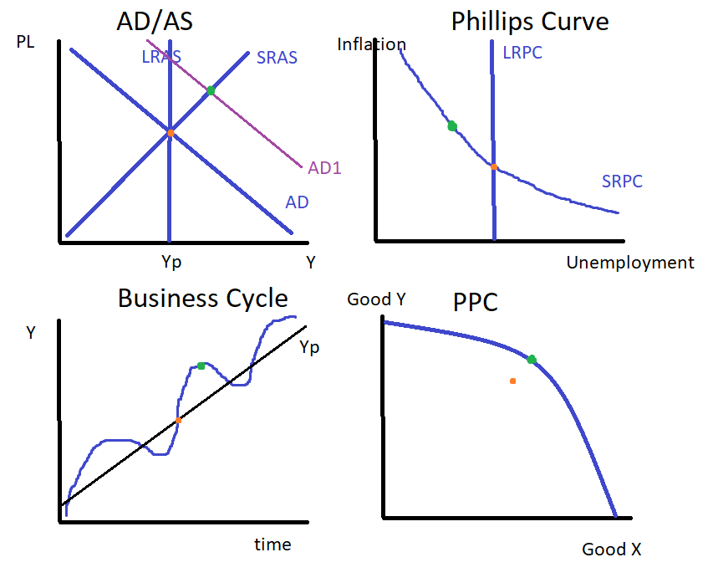

Positive Output Gap/Inflationary Gap

Slide 45
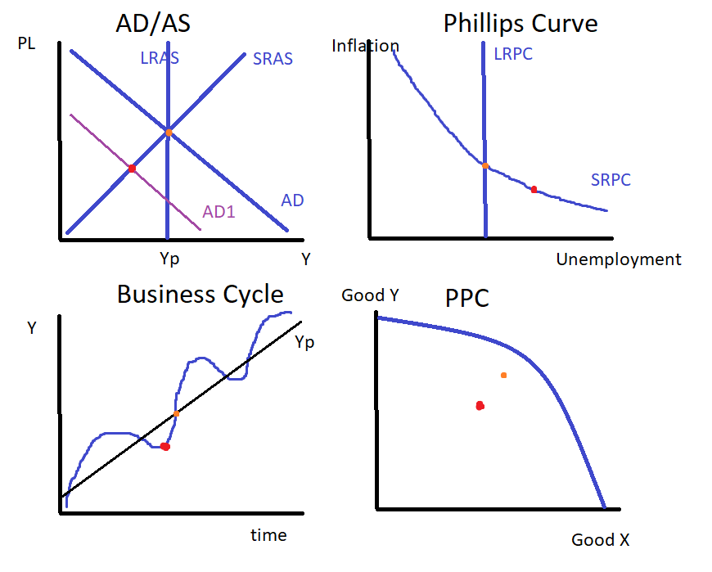


Negative Output Gap/Deflationary Gap

Slide 46
Graphing Homework

Slide 47
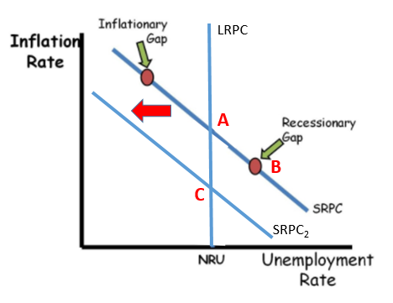
Government Policy and the Phillips Curve
Historical Context: Paul Volcker fights high inflation in the 1980s.
What Paul Volcker taught us about taming inflation I Charts That Count – YouTube
When policymakers want to control inflation, it often comes at the cost of lower output and unemployment.
However, high and unstable inflation is also a big problem.
Policymakers sometimes have to make the hard decision of slowing the economy.
Therefore, we will see a movement along the SRPC toward lower inflation and higher unemployment.
At first the decision to fight inflation caused a contraction in the economy (A->B). However, once people began to anticipate the lower inflation level, the economy returned back to an equilibrium with a lower level of inflation.

Slide 48
Why were the policies of the then Federal Reserve Chairman Paul Volcker considered ‘brave’ at the time?
Because in order to control inflation the economy would inevitably enter into a recession.
However, in hindsight, many consider this policy to be the correct one to bring inflation under control.

